Slide 1
Charcoal.com.pk
Submitted by:
2021-SE-30
2021-SE-39

Slide 2
Visibility

Slide 3
What is this?
Charcoal menswear was founded in Pakistan in 2008 and is now one of the leading retailers of apparel and accessories for men from its beginning as a manufacturer of casual and formal clothing, charcoal has developed into one of the most leading brands in Pakistan.

Slide 4
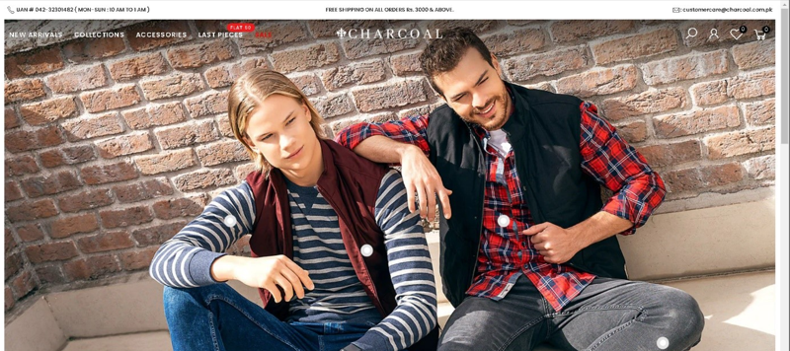
Website Logo
Logo is not clearly visible.
User might click on picture instead Logo.
Not properly shown.

Slide 5
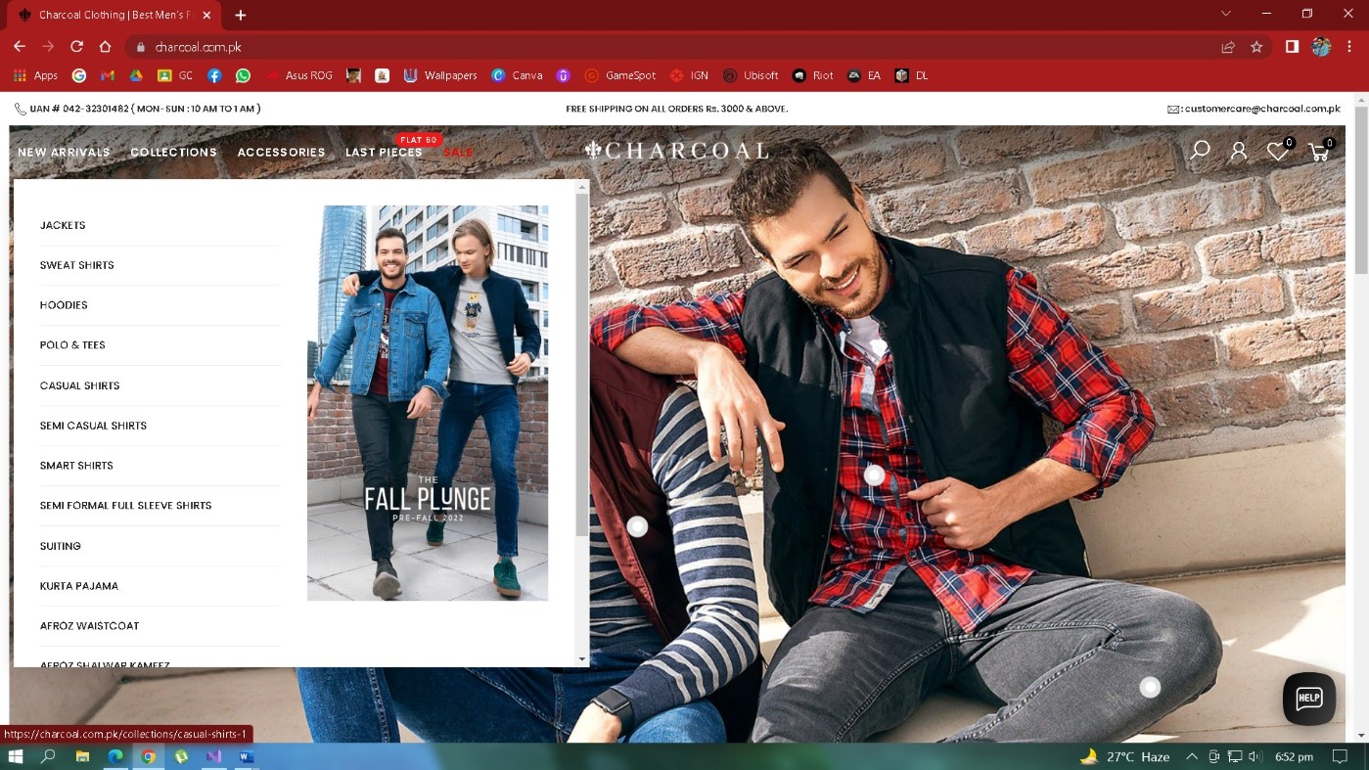
Feedback Or Response
Not showing any effect on sub-categories when click.

Slide 6
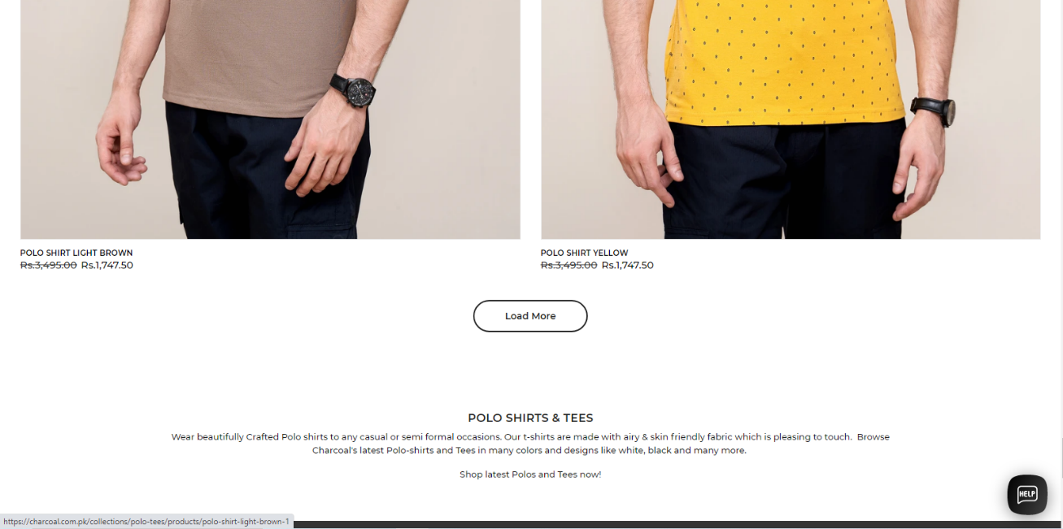
Pagination
Pagination available
Instead pagination more button is available.

Slide 7
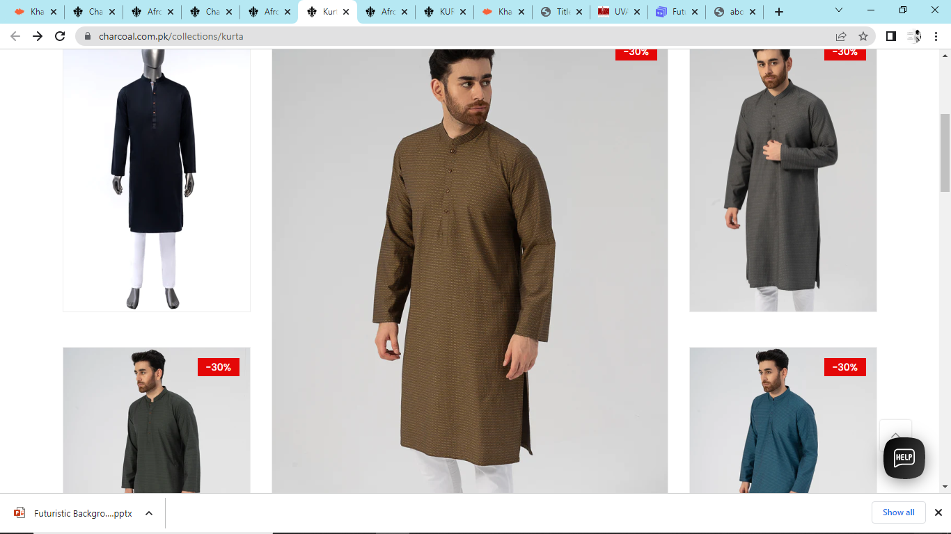
Product Images
Extensively large product images.
Some product skipped.

Slide 8
Search Bar
No proper Search Bar available.
Sub-level of search bar.

Slide 9
Simple & Natural Language

Slide 10
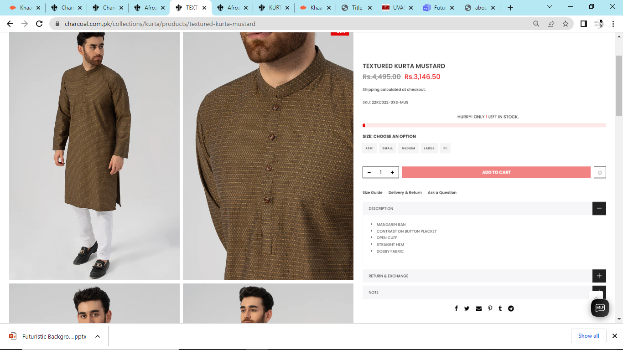
Product Details
Too much information.
Unnecessary information like Stock left.

Slide 11
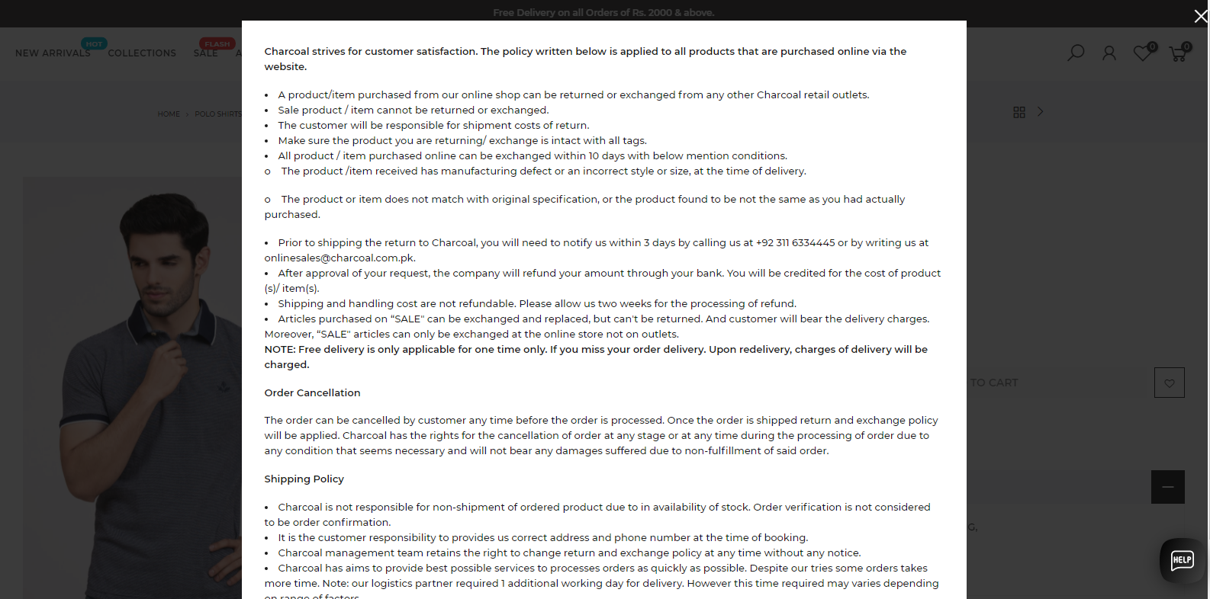
Delivery & Return product
A lot of agreements.
Simple language should be used in Delivery and Return

Slide 12
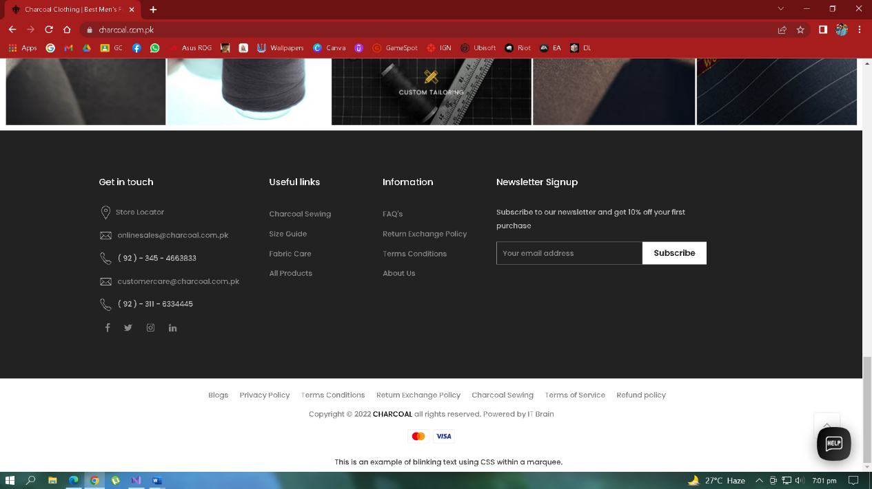
Footer unnecessary data
Contain unnecessary options.
Example: Technical, Domain related, Business related etc.

Slide 13
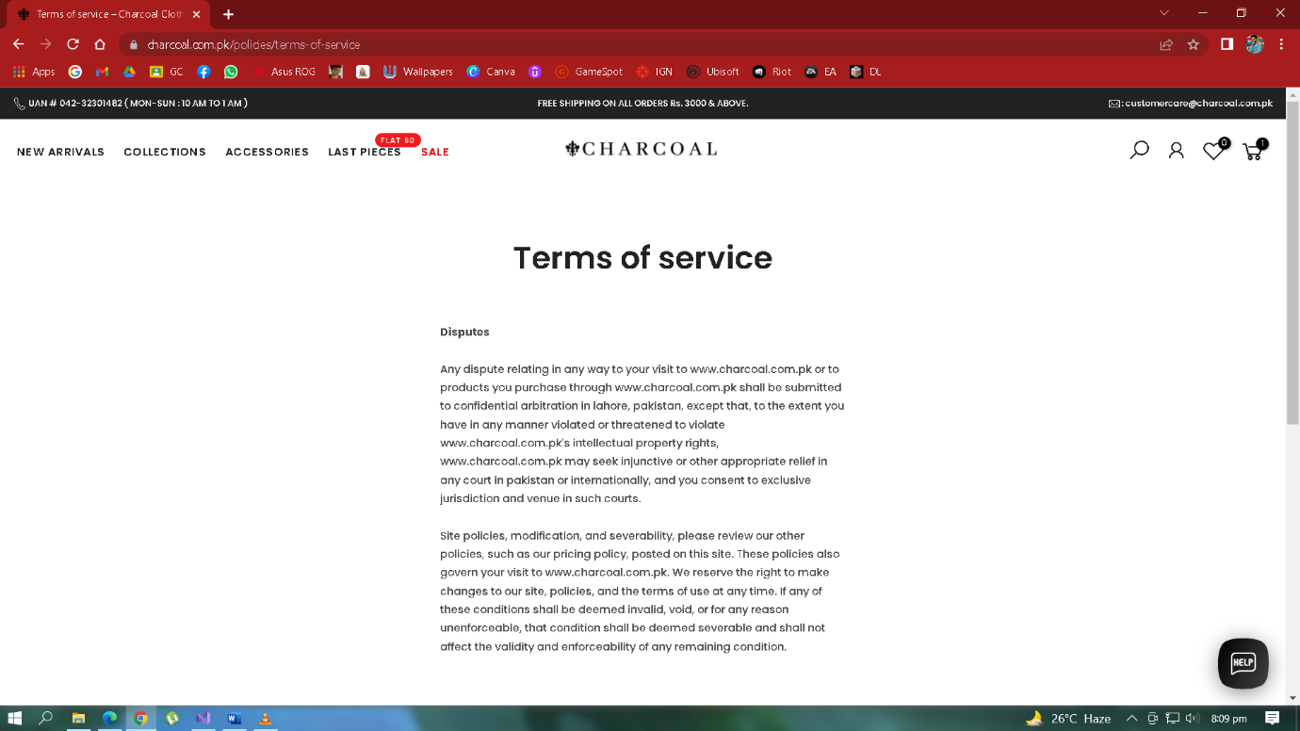
Minimize user’s memory load
Return & exchange policies are too much.
Difficult to remember.
Policies should be simple to remember.

Slide 14
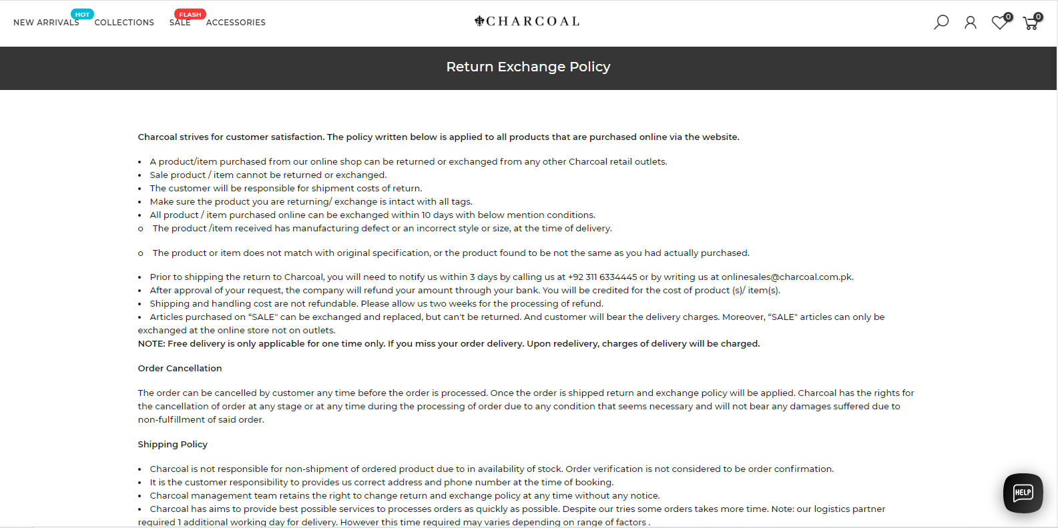

Slide 15
Consistency

Slide 16
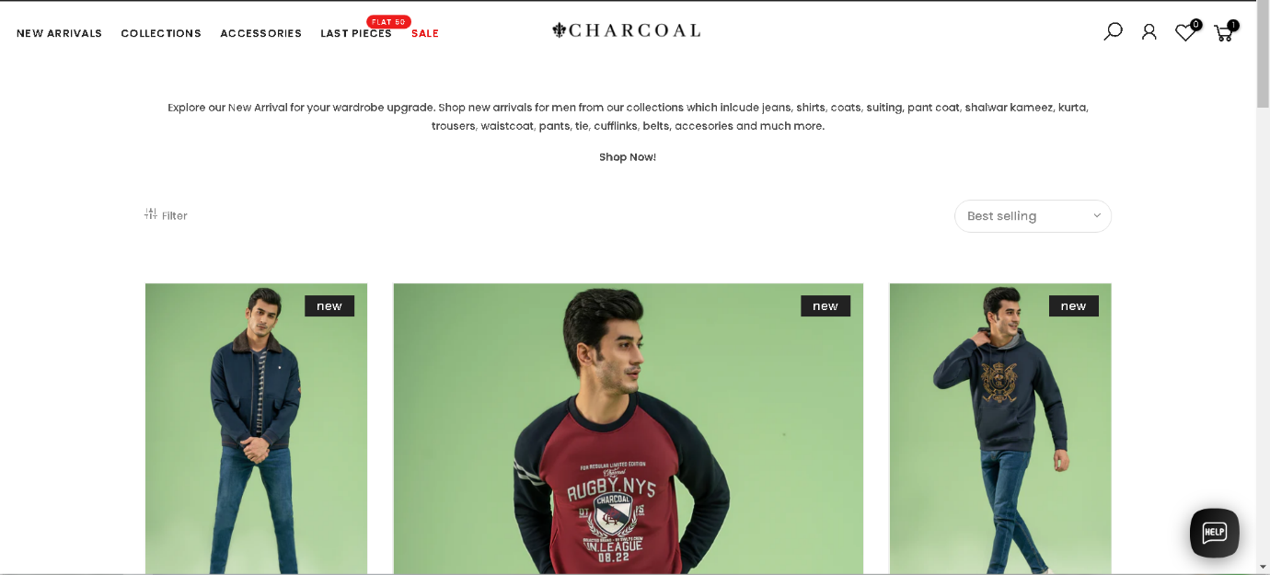
Product category & menu
Consistency is present in whole Website.

Slide 17
Website structure
Static Navbar.
Static Footer.

Slide 18
User control & freedom

Slide 19
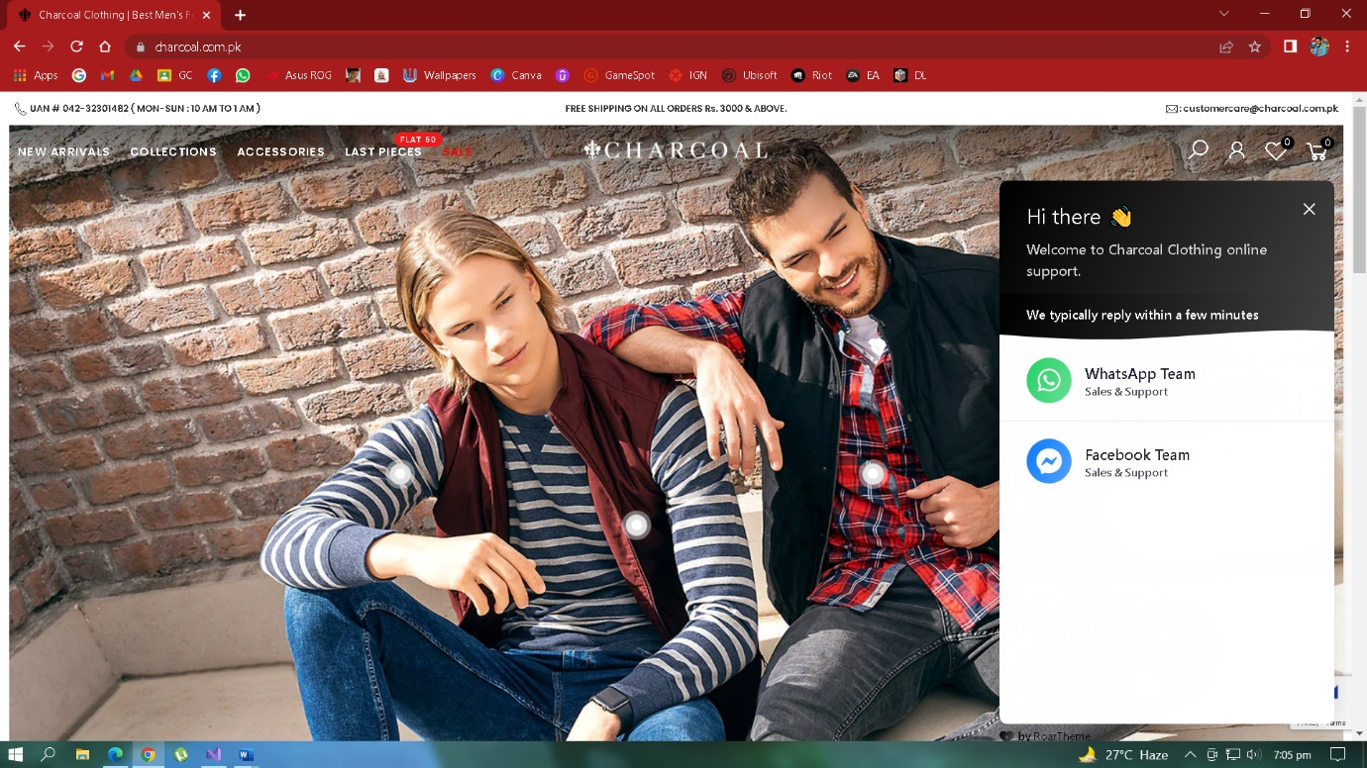
Help & support
Dedicated Customer Help and Support button.
Other Communication platform also available.
Example: WhatsApp, Messenger.

Slide 20
Browse Products
Load More button available.
breadcrumbs not available.

Slide 21
Support Undo

Slide 22
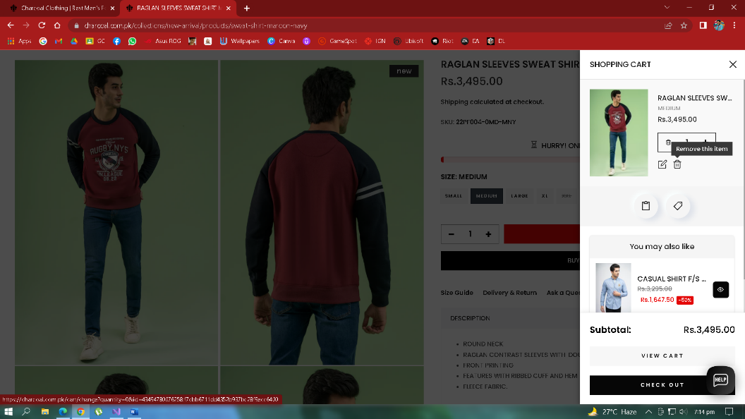
Remove Products
Products cab be removed from cart.
Quantity can be increased & decreased in cart.
Products can be added & removed from my favorites.

Slide 23
Shortcuts

Slide 24
Product categories & menu
Static Navigation bar is doing it.

Slide 25
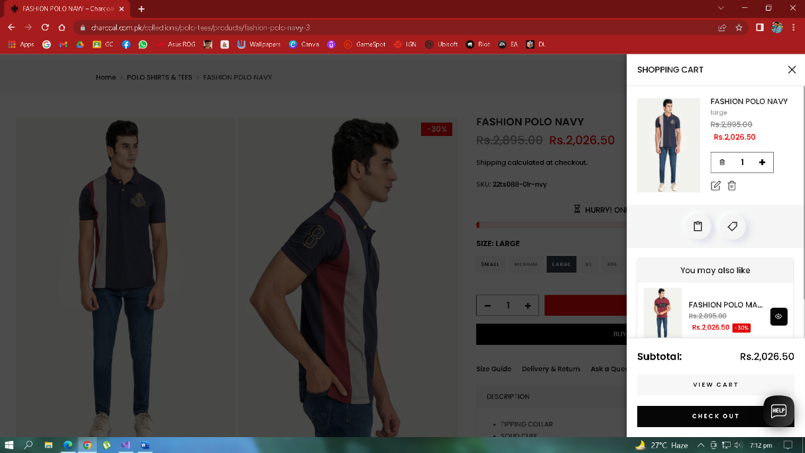
Cart items
Can check all purchased and wish-listed products.
Products can be added, removed and proceed to checkout.

Slide 26
Deal with errors

Slide 27
Remove Products
No Confirmation messages shown, when item deleted from cart.
Should display confirmation message, when cart item is disturbed.
To prevent accidently selection.

Slide 28
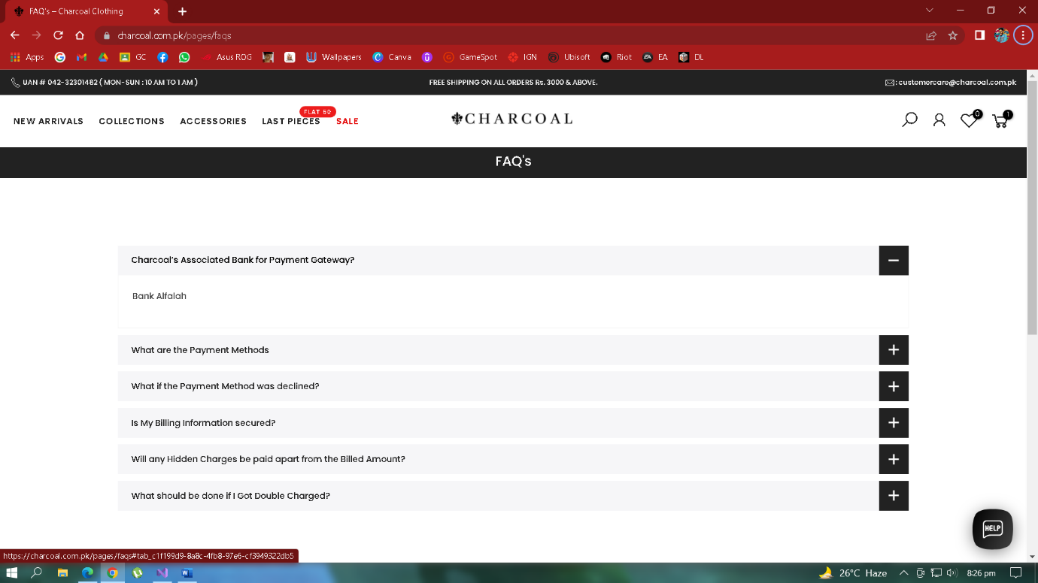
FAQ
If user stuck, can check FAQ.

